Slide 4
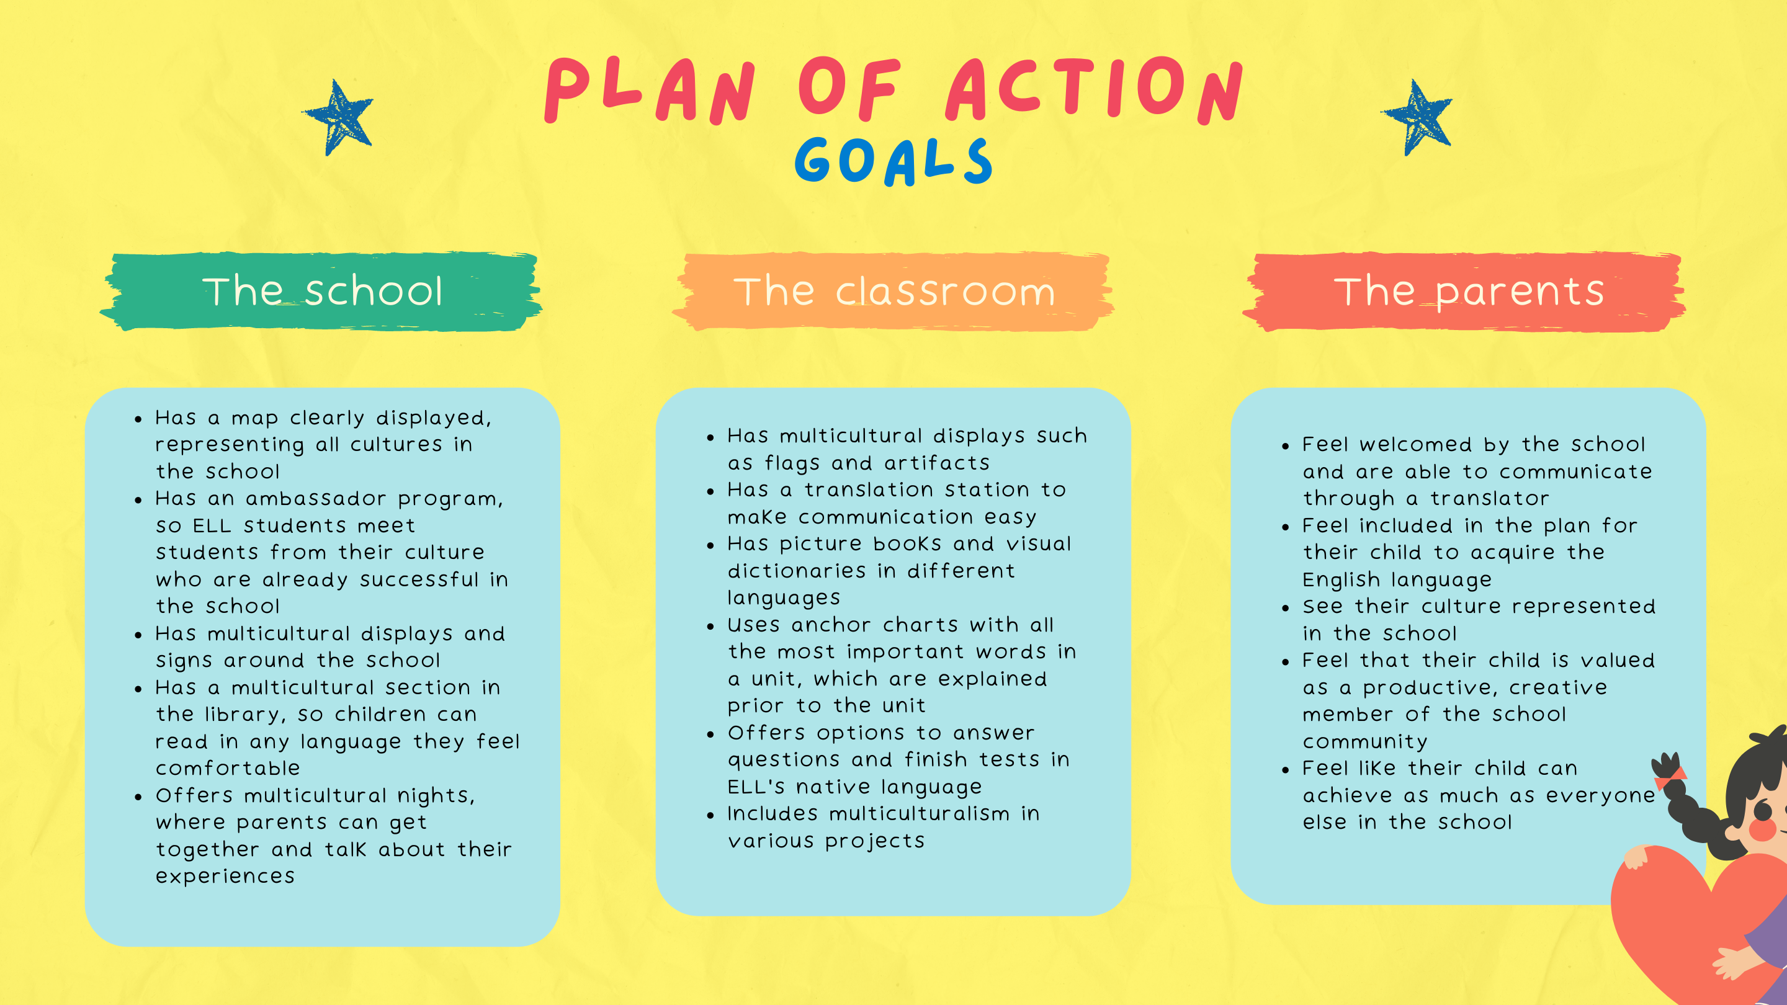

Slide 10
https://www.funbrain.com/
https://www.duolingo.com/
https://breakingnewsenglish.com/
https://www.raz-kids.com/
https://www.eslvideo.com/
https://iearn.org/

